Slide 1
Beyond the Login : Profiling Digital Behavior of Public WiFi Users in Indonesia
This project analyzes user behavior patterns from public WiFi hotspot login data across major Indonesian cities. The analysis covers demographic segmentation, device preferences, digital interest levels, and login time patterns to extract actionable business insights for location based digital marketing.
Q1 / March 2026
Presented by
Qodri Muhamad
Github Repo
Portofolio
qrocketlab
March
2026

Slide 2
Content
1
Background
6
When do they login?
2
Data Overview
7
How digitally engaged are they?
3
Who are the users?
8
Statistical confidence
4
Where do they connect?
9
Actionable recommendations
5
What device do they use?
10
Tools and Methodology
qrocketlab
March
2026

Slide 3

"Every day, thousands of users log into public WiFi hotspots across Indonesia. They enter their name, email, and phone number. But what do we actually know about them?"
Background
qrocketlab
March
2026

Slide 4
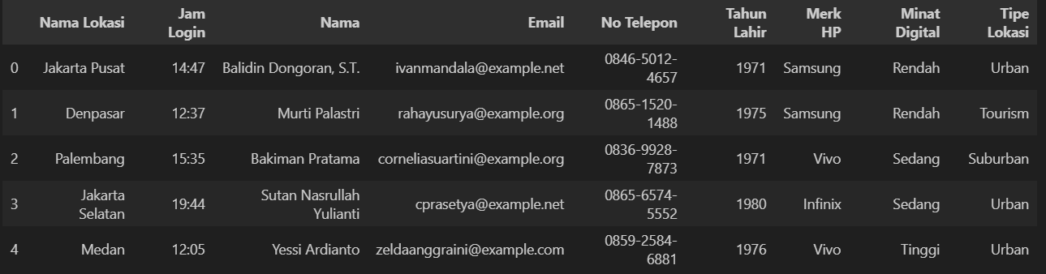
Data Overview
The dataset was synthetically generated using Python's Faker library with Indonesian locale (id_ID) to simulate realistic WiFi captive portal login records. Each record mirrors the data structure that platforms would collect when a user connects to a public WiFi hotspot: personal details filled in by the user, device information detected by the system, and a timestamp logged automatically. Weighted random distributions were applied to variables such as device brand and digital interest level to approximate real Indonesian market proportions.
qrocketlab
March
2026

Slide 5
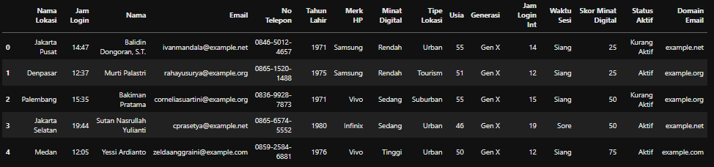
Data Overview
Derived variables through feature engineering (6 new columns):
- Usia, Generasi, Waktu Sesi, Skor Minat Digital, Status Aktif, Domain Email
qrocketlab
March
2026

Slide 6
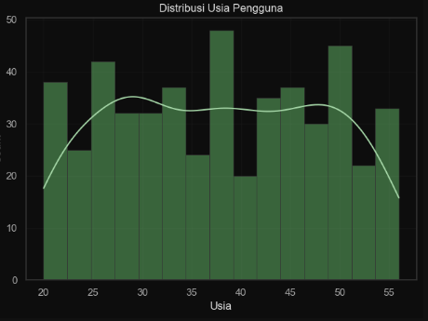
Who Are the Users?
Age Profile:
Average age: 37.75 years (95% CI: 36.83 to 38.67)
Spread across all generations, strongest in Millennial and Gen X
Generation Breakdown:
Gen Z, Millennial, Gen X, Boomer segments present
Working professionals dominate over students
qrocketlab
March
2026

Slide 7
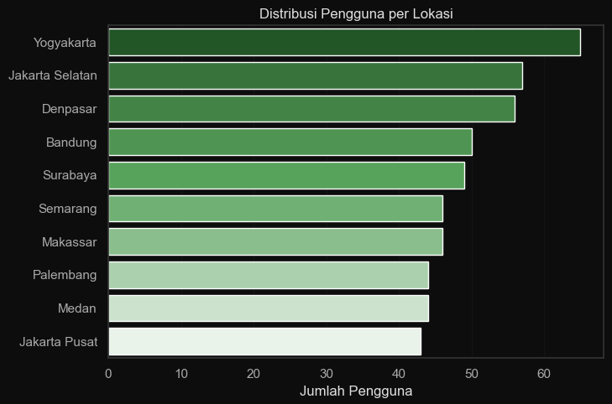
Where Do They Connect?
Top locations by user volume:
Yogyakarta and Jakarta Selatan lead adoption
Tourism locations (Yogyakarta, Denpasar) perform on par with urban centers
Palembang (Suburban) shows promising early traction
Takeaway: Hotspot placement strategy should not ignore tourism and suburban areas.
qrocketlab
March
2026

Slide 8
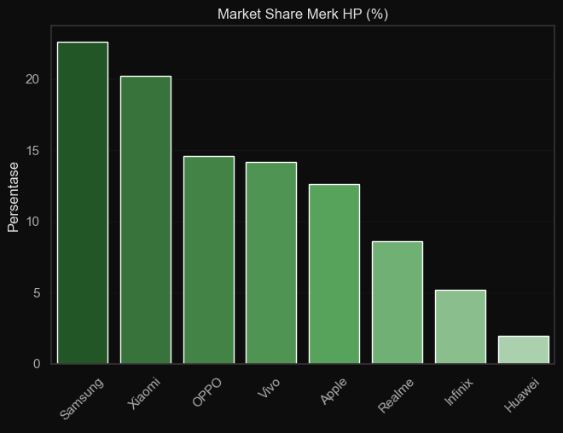
What Devices Do They Use?
Market share among hotspot users:
Samsung: 23%
Xiaomi: 20%
OPPO: 14%
Vivo: 14%
Apple: 13%
Others: 16%
Takeaway: Login portal and ad creatives must be optimized for Samsung and Xiaomi first. Apple users, while fewer, may represent a premium segment.
qrocketlab
March
2026

Slide 9
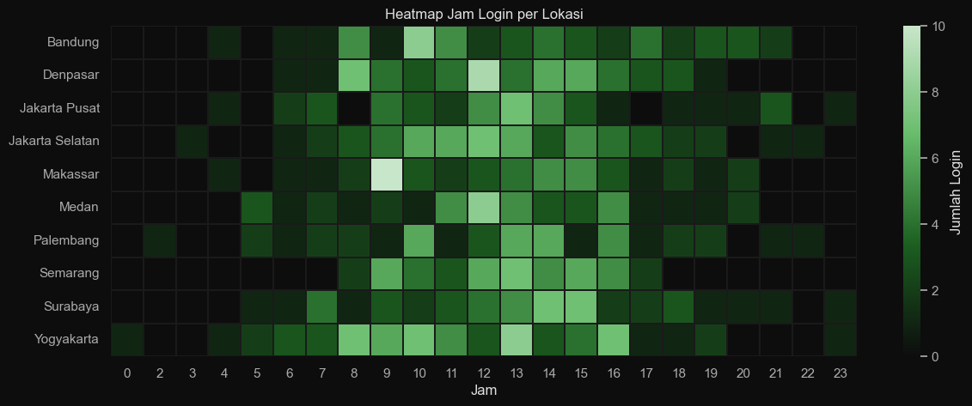
When Do They Log In?
Peak login window: 11:00 to 14:00 (lunch hours)
Secondary peak: 08:00 to 10:00 (morning arrivals)
Low activity: after 20:00
Pattern consistent across all 10 locations.
Takeaway: Promotional push notifications and ad delivery should be scheduled within the 11:00 to 14:00 window for maximum reach
qrocketlab
March
2026

Slide 10
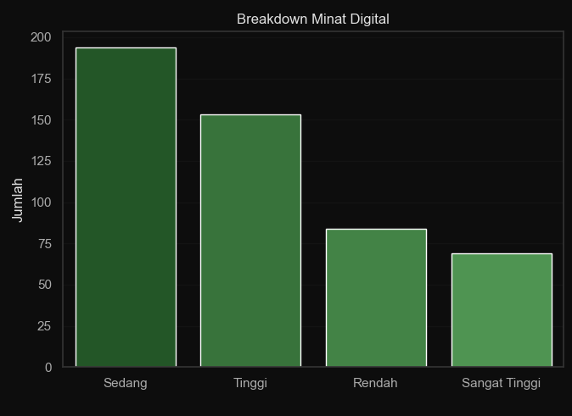
What Devices Do They Use?
Digital interest distribution:
- Sedang (Moderate): 39%
- Tinggi (High): 31%
- Rendah (Low): 17%
- Sangat Tinggi (Very High): 14%
Average digital interest score: 59.66 (95% CI: 57.73 to 61.59)
Takeaway: 70% of users have moderate to high digital interest. This is a receptive audience for digital campaigns. The top 14% can be targeted as early adopters.
qrocketlab
March
2026

Slide 11
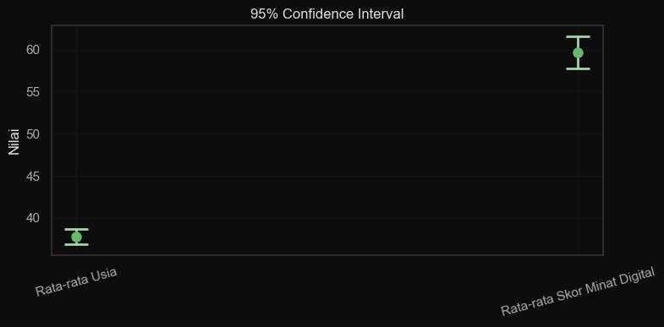

95% Confidence Interval using t distribution
Method
Why this matters: These intervals are narrow, meaning the estimates are reliable enough for business planning.
Campaign design can target the 36 to 39 age range and assume moderate to high digital readiness.
qrocketlab
March
2026

Slide 12



Tools and Methodology
Optimize login portal for Samsung and Xiaomi devices (43% combined share)
Schedule campaigns during 11:00 to 14:00 peak window
Expand hotspot placement to tourism and suburban areas showing strong adoption
Segment campaigns by generation: digital fluency messaging for Gen Z and Millennial, trust and simplicity for Gen X and Boomer
Use the "Sangat Tinggi" interest group as beta testers for new digital features
qrocketlab
March
2026

Slide 13
Tools and Methodology
Language: Python 3
Environment: Jupyter Notebook
Libraries: pandas, numpy, faker, scipy, matplotlib, seaborn
Approach:
Synthetic data generation with realistic Indonesian distributions
Feature engineering to create analytical variables
Exploratory data analysis with 5 visualizations
Confidence interval calculation using t distribution
Learn more
qrocketlab
March
2026

Slide 14
Thank you
Ready for what’s next?
Let’s talk
Qodri Muhamad
qodrimuhamad98@gmail.com
+61 812-1268-1718
qrocketlab
March
2026

